Slide 1
Parkview Cardiology Device Clinic Resource Page
Find the answer to all your device related questions in one place

Slide 2
Identifying a problem
As the Device clinic was expanding, we realized the need for a centralized location for all workflows and policies.
  Each staff member was printing emails about policy updates and changes
  In addition to one policy binder at the main office, staff kept their own files for reference
  It became difficult to know which resource was the most up to date. Efficiency and continuity of patient care became an issue.
  As the clinic expanded to more locations and work from home became more regular, the need to ensure all staff had access to the current workflows and policies was apparent regardless of which location they were working at for the day.

Slide 3
Implementing a Solution
After searching through options, we discovered our hospital system's internal browser, SharePoint, allowed for each department to create its own webpage.
The webpage included a variety of templates available to help build the department site.
After trial and error, I was able to create a webpage for the Device Clinic that expanded beyond our initial goals to something that is used daily by all nursing staff.

Slide 4
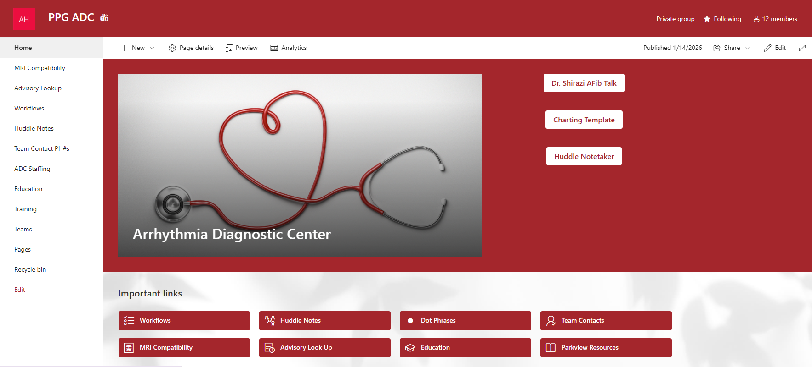
ADC Webpage

Slide 5
Functionality
The clinic page includes hyperlinks to resources we use daily
  MRI Compatibility: hyperlinks to the MRI look up tools for each company
  Advisory Lookup: hyperlinks to the device advisory pages
  Workflows: links to each device clinic workflow. These can be updated as needed with each staff member able to access the current policies
  Huddle Notes: Notes from each unit meeting is included for review in one place.
  Education: A summary of each vendor in-service. Educational pieces developed by our own department can be found in one place as well.
  Contact phone numbers: Contact information for each vendor and desk phone for department staff
  Staffing Resources: Staffing guidelines, vacation schedules, attendance policy, vacation staffing requirements.

Slide 6
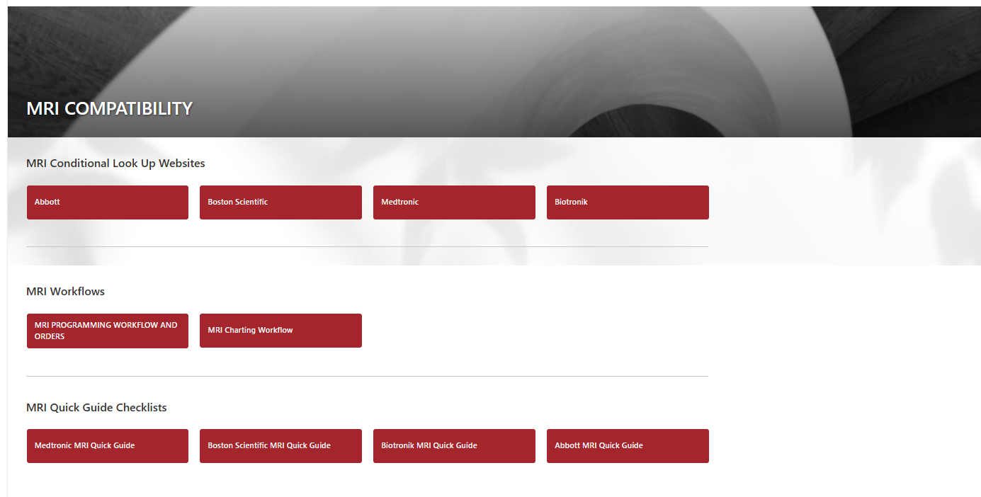
MRI Compatibility

Slide 7
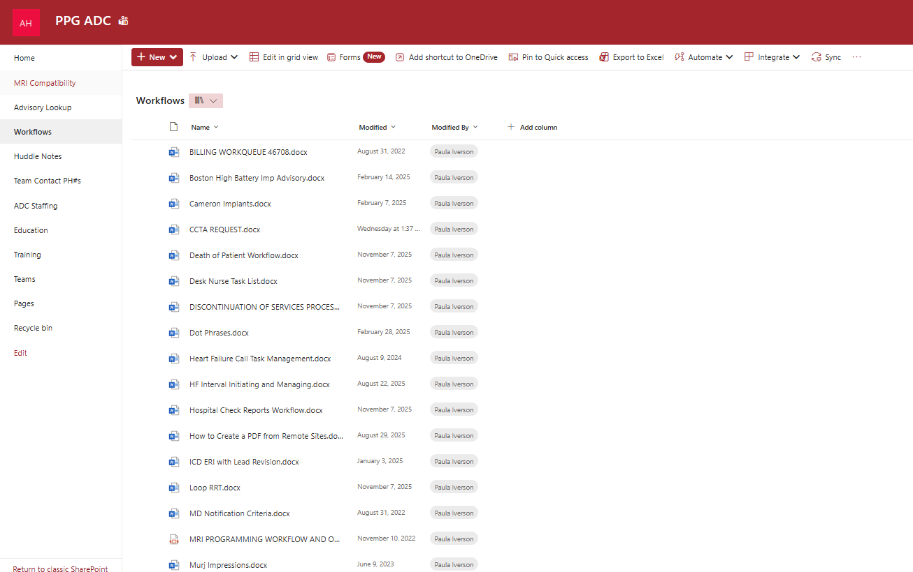
Workflows and Policies

Slide 8
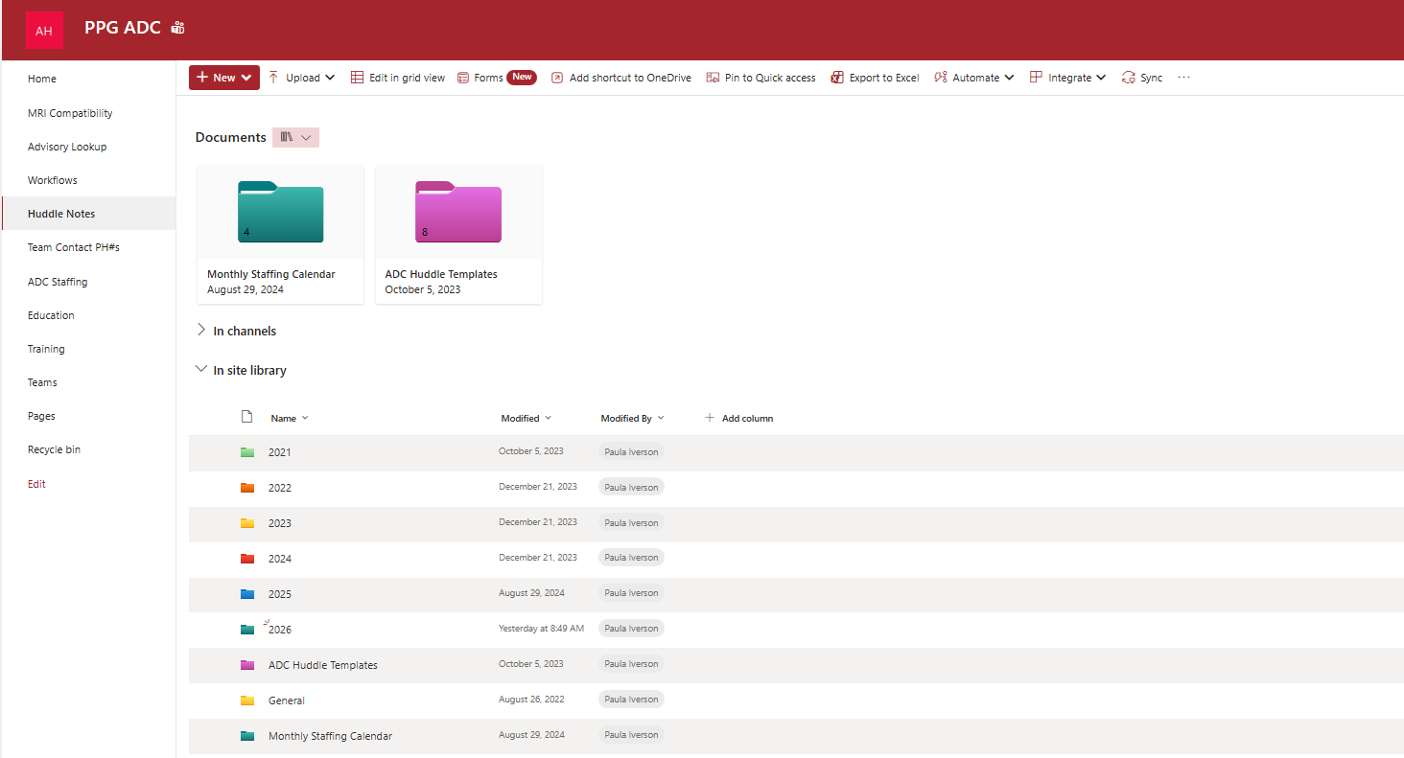
Huddle Notes

Slide 9
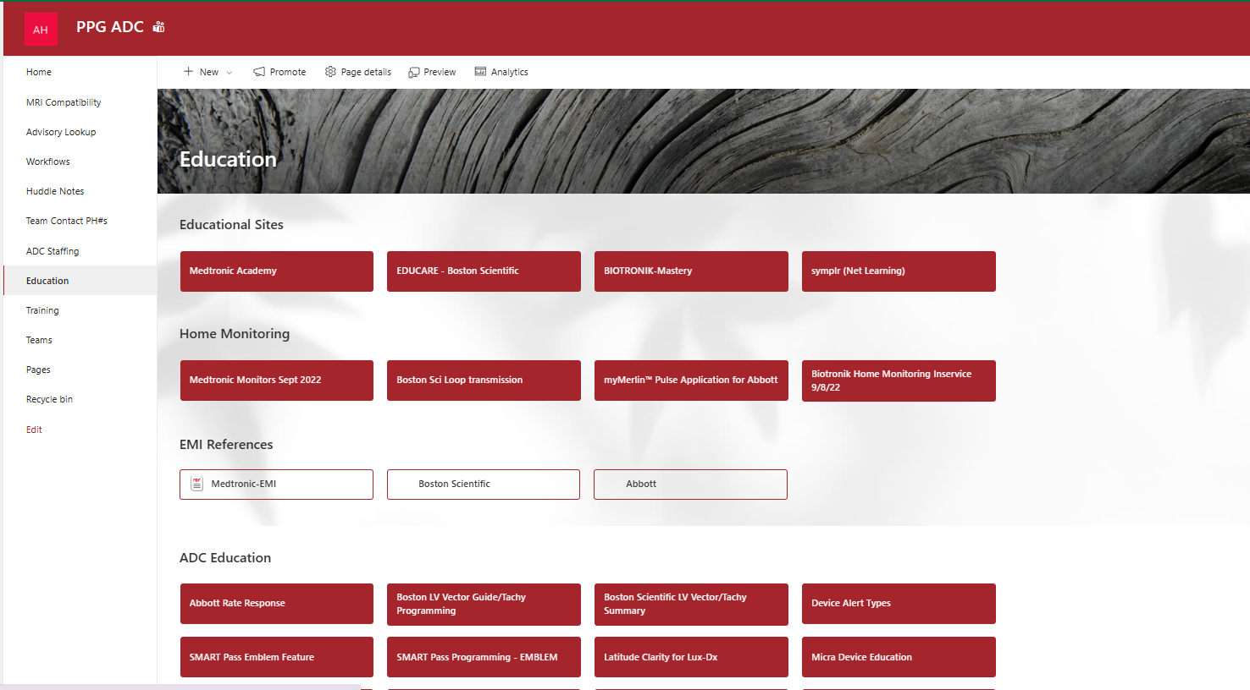
Education

Slide 10
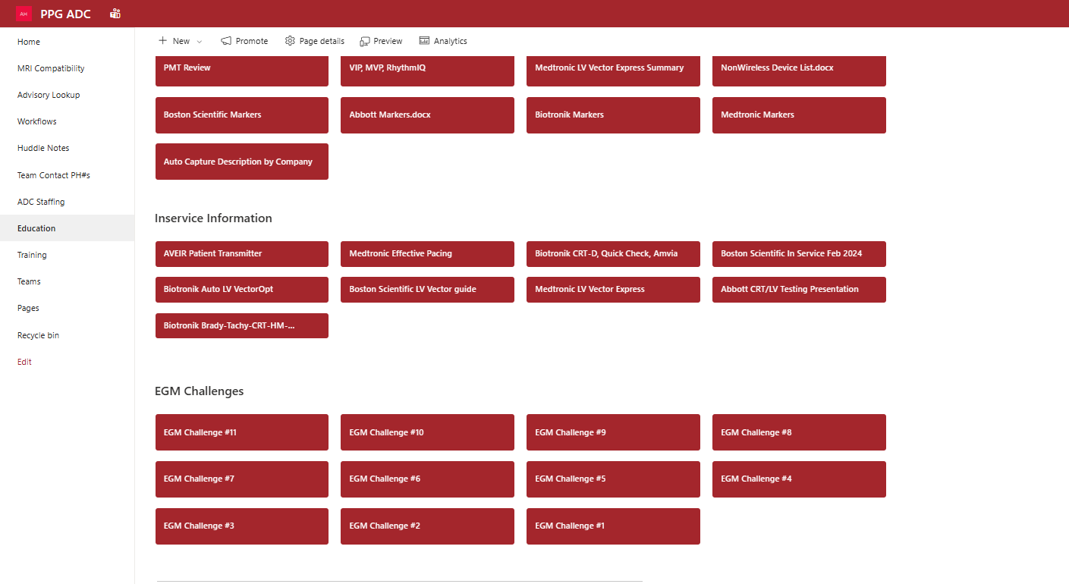
Education cont'd

Slide 11
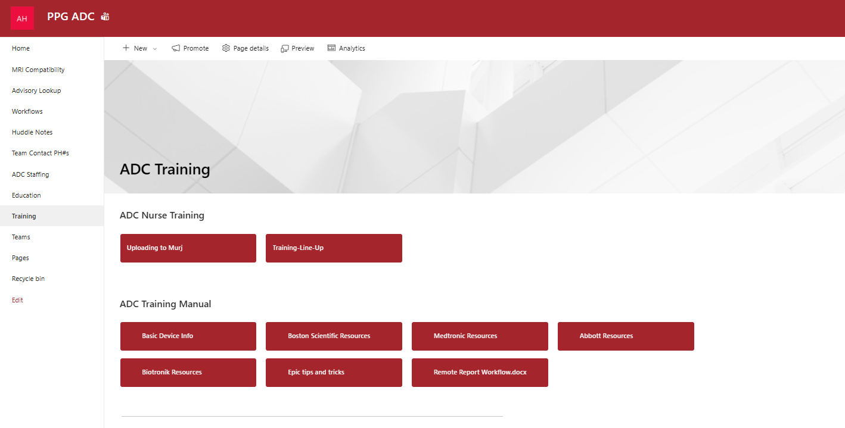
Training

Slide 12
Conclusion
What started as a problem rooted in "this is how we've always done it" turned into a solution that had a far-reaching impact on how the staff handle daily tasks.
The resource page has become an integral part of the department and changed the way we operate on a day-to-day basis.
Staff report keeping the page continuously open in a tab on their web browser to reference while completing both in office and remote checks.
Productivity and efficiency have increased with the workflows being easily accessible.
Management can update workflows quickly and still ensure all staff have access to the updated information.

