Slide 1

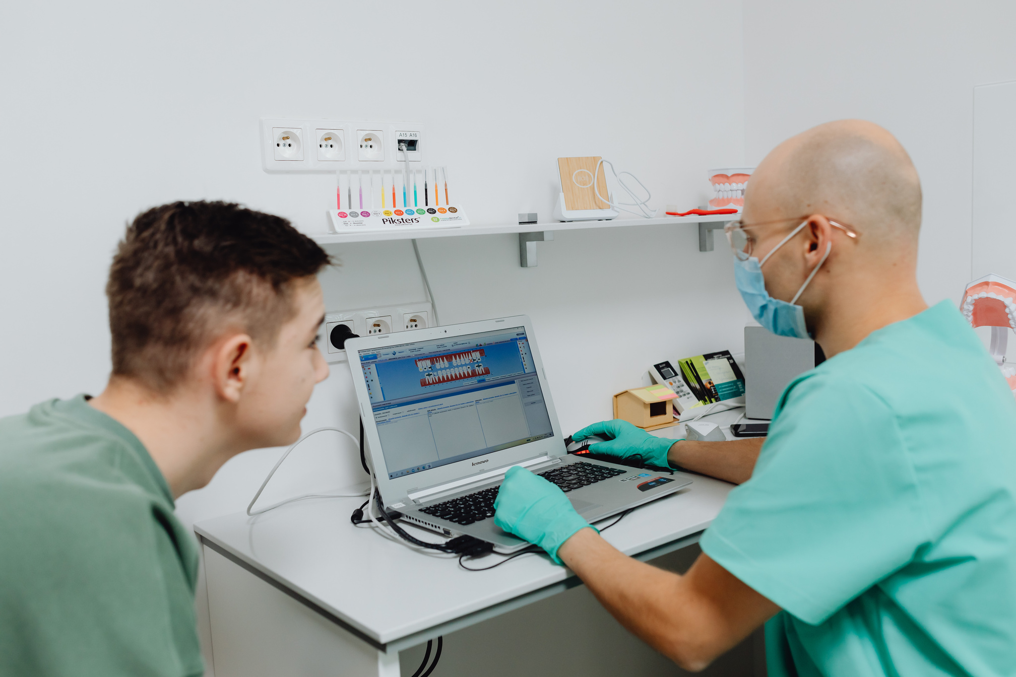

Alert Triage Workflow
For CIED Remote Monitoring Clinics
Presented By:
Dr Srividya Narayanan
Apekshit Mhatre

Slide 2


Problem - Alert Overload Crisis
Device clinics face 300-600 remote monitoring alerts per day → That's 3-5x more workload than in-person follow-up.
Clinic managers spend 4-6 HOURS daily manually triaging alerts → With NO standardised workflow
50% of clinics report dissatisfaction with current processes → Leads to missed alerts, staff burnout, compliance gaps

Slide 3
What ALERT OVERLOAD really costs?
Patient Safety Liability
Real case examples (lead failure, AF episode)
$50K-$200K+ per incident
$500K-$2M+ annual exposure
Regulatory Compliance Risk
What auditors will ask
Consequences of a failed audit
$200K-$1M+ annual cost
Reimbursement Revenue Loss
40% of clinics lose 30-40% of billing
$3.1M exposure math
$100K-$500K+ annual loss
TOTAL: $300K-$2M+ per clinic annually

Slide 4

❌ Alerts pile up in clinic inbox
❌ No clear escalation path
❌ Each tech interprets urgency differently
❌ Some high-priority alerts get buried
❌ Patient calls are not returned consistently
❌ Billing documentation incomplete
❌ Staff burnout
What happens without a WORKFLOW ?

Slide 5

Revenue Risk
Missed billing opportunities
Quality Risk Inconsistent patient outcomes
Patient Safety Risk
Missed critical alerts (lead failure, AF episode)
Ripple
Effect
Burnout
Staff turnover, recruitment challenges
Compliance Risk
Inadequate documentation for audits

Slide 6

Solution - Alert Triage Workflow
Based on IMDRF QMS Principles + Real Clinic Optimization
SOP Template
Alert Scoring Checklist
Staffing Calculator Tool
Standardised rules that map vendors → unified urgency levels
Auto-generates audit trail + documentation
One laminated card works for ALL vendors
Color-blind friendly
Cognitive-load tested
Calculates exactly how much cognitive capacity your team has
Accounts for decision fatigue + alert quality decline over time

Slide 7








ALERT TRIAGE FLOW MAP
DEVICE
Generates Alert
BATCH PROCESS
Group daily
Document
ESCALATION PATH
Notify MD
Contact Patient
VENDOR CLOUD
Receives Alert
Auto-reviewed: 1-15 min
DOCUMENTATION
Record in EHR/QMS
Archive for audit
TECH REVIEWS
Categorizes Urgency
RED / YELLOW / GREEN
CLINIC DASHBOARD
Alert Appears
BILLING/CODING
Capture CPT codes
Submit for reimb.

Slide 8

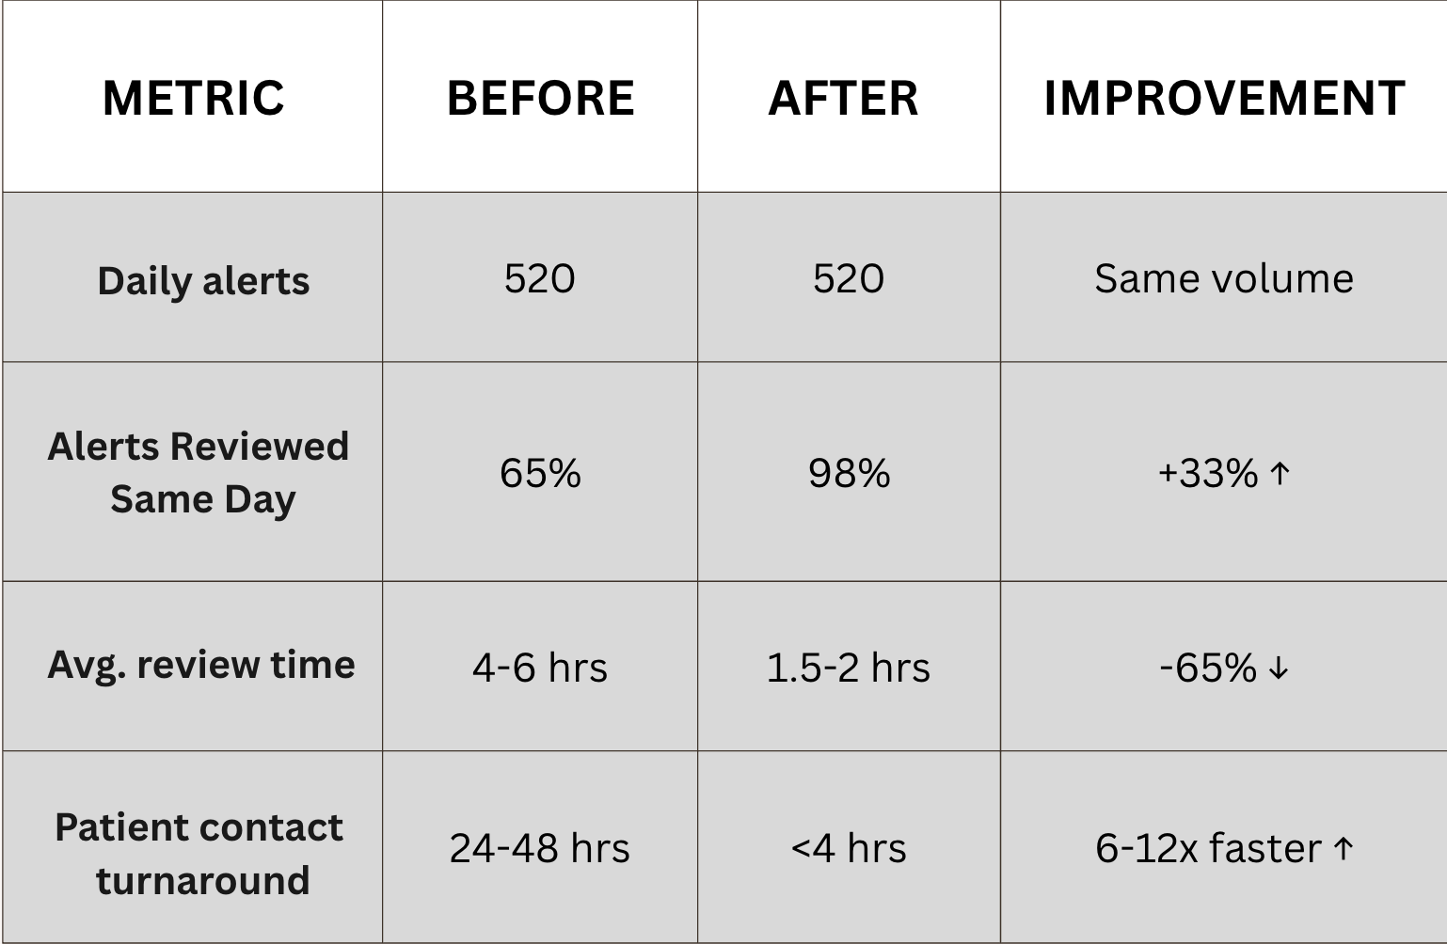
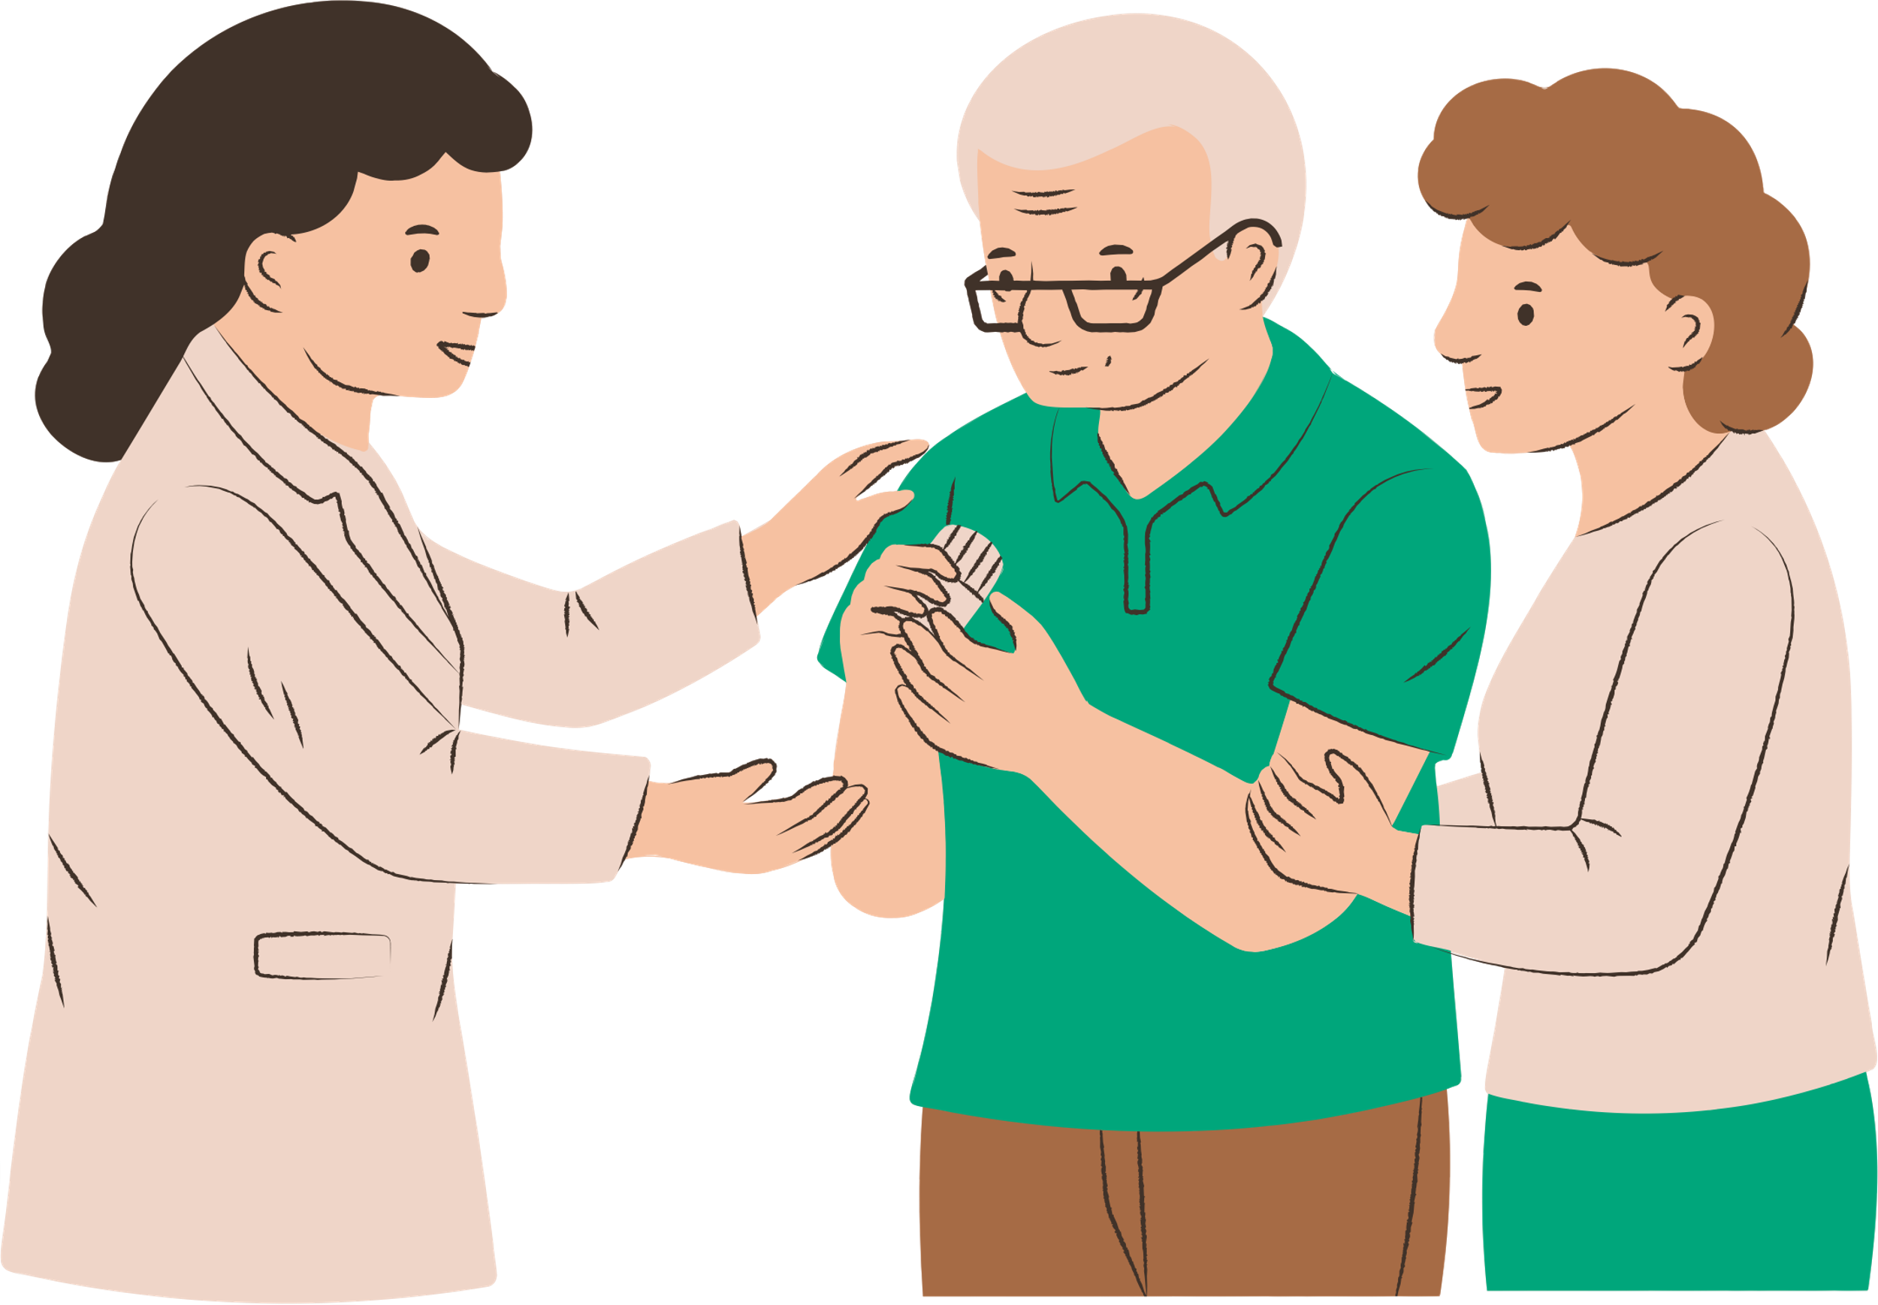

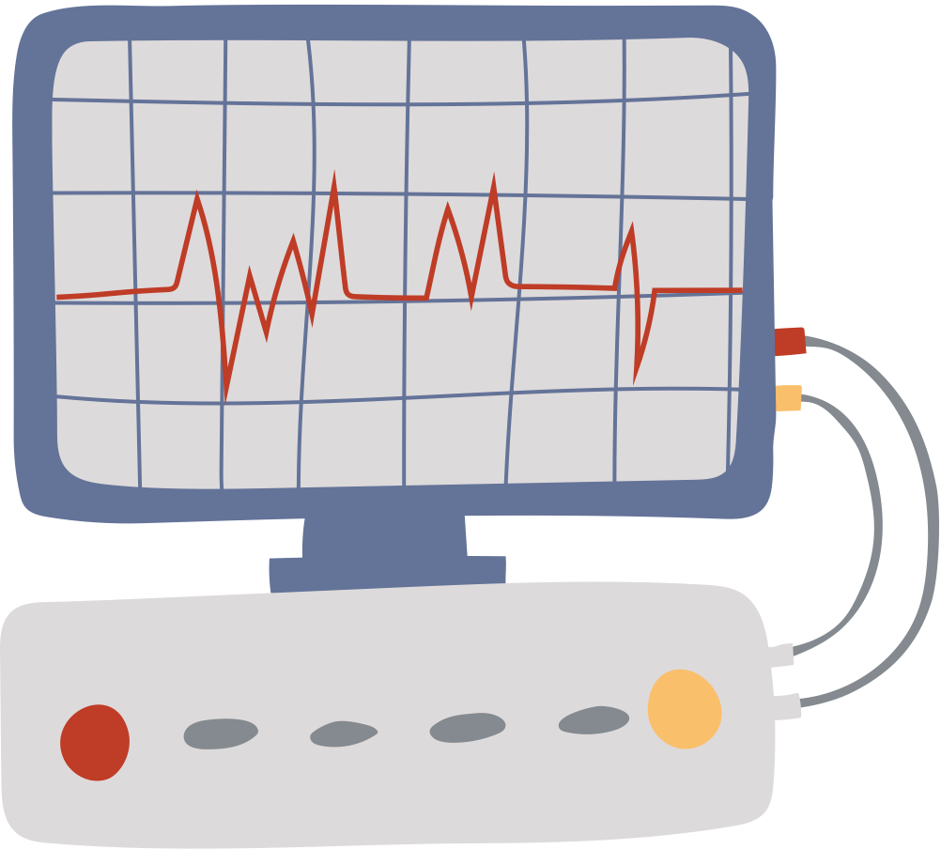


Case Study: How Clinic Cut Triage Time
Mid-Size CIED Clinic
850 active patients
2 device vendors
(Medtronic + Boston Scientific)
Remote monitoring: Carelink + Latitude
Staffing: 2 techs (FT) + 1 nurse (0.5 FTE)
EP physician: 20 hours/week clinic time

Slide 9
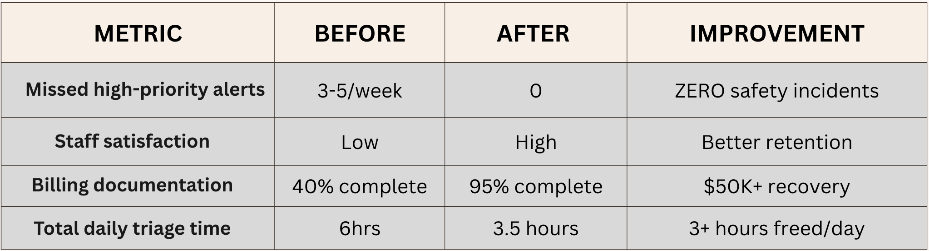
IMPACT METRICS
3+ hours/day freed up for patient care
Zero missed critical alerts (6-month data)
Staff morale improved ("We feel in control now")
Compliance-ready for audits
Better billing capture = $50K+ annual revenue recovery
RESULTS

Slide 10
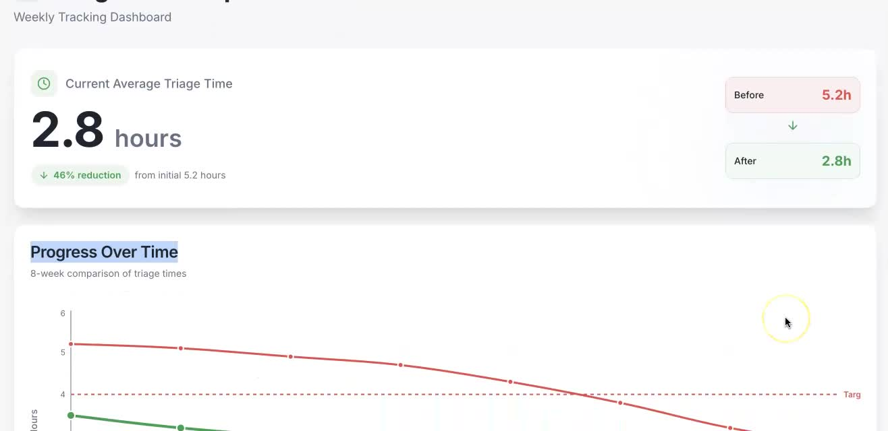
TRIAGE TIME IMPROVEMENT

Slide 11

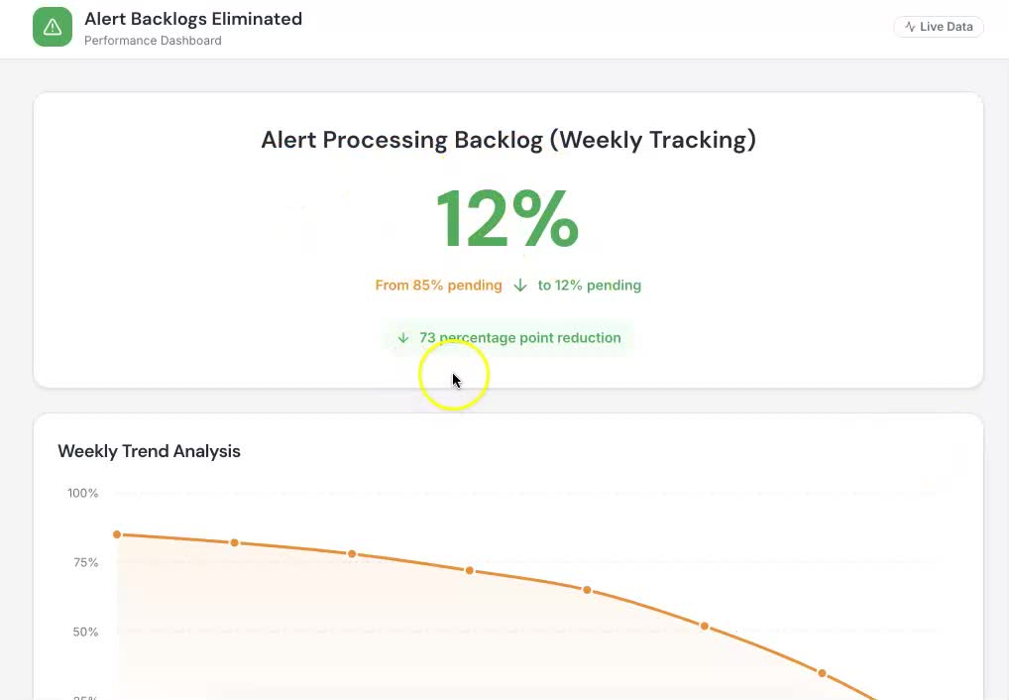
ALERT BACKLOGS CHART

Slide 12
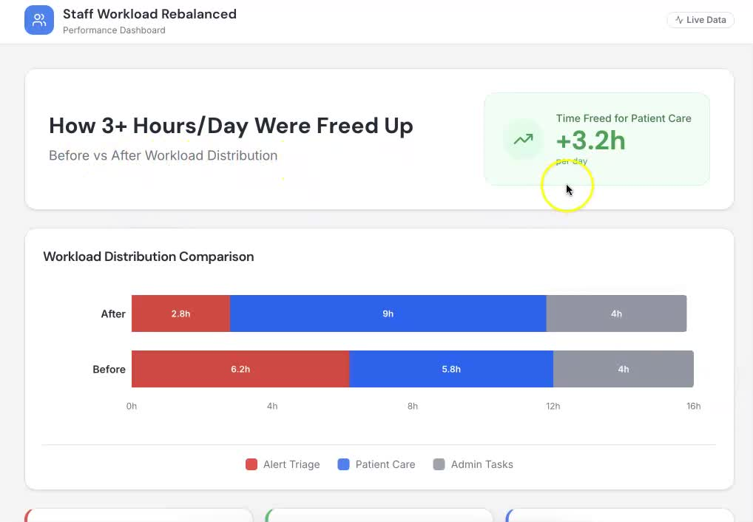
STAFF WORKLOAD
CHART

Slide 13
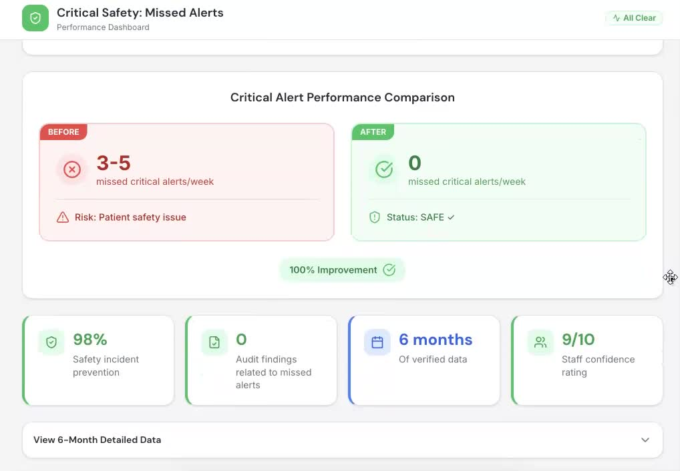
SAFETY METRIC GAUGE

Slide 14
TOOLKIT + HUMAN FACTORS
ALERT TRIAGE SOP
ALERT SCORING LIST
STAFFING CALCULATOR
✓ Full 7-step procedure
✓ Roles & responsibilities
✓ Turnaround time matrix
✓ Patient contact scripts
✓ Documentation checklist
✓ Escalation flowchart
✓ Regulatory references
✓ Color-coded by urgency
✓ RED / YELLOW / GREEN
✓ Printable 5"x7" card
✓ Laminate-friendly
✓ Quick reference guide
✓ Clinic-ready in 48 hours
✓ Interactive web/Excel tool
✓ Input your clinic data
✓ Auto-calculate staffing needs
✓ Staffing gap analysis
✓ ROI + cost justification
✓ Real-time results

Slide 15

Smart Design: Alert Fatigue Prevention
JOIN THE ALERT TRIAGE REVOLUTION
Every team member reads
the same checklist
Never more than 5 critical
alerts per review cycle
Color-coded urgency levels
= faster decisions
Group non-urgent alerts
= fewer interruptions

Slide 16
QUALITY & COMPLIANCE
QUALITY IMPROVEMENT FRAMEWORK
REGULATORY ALIGNMENT
✓ Standardized decision-making
(eliminates clinician variability)
✓ Documented SOP
(21 CFR 820.75 compliant)
✓ Audit trail
(every alert reviewed, logged, resolved)
✓ Staff training documented
(competency verification)
✓ Measurable outcomes
(before/after data collection)
✓ Missed alert prevention
(zero tolerance for critical alerts)
✓ 21 CFR 820.75
Process validation & change control
✓ IEC 62366
Human factors engineering & usability
✓ FDA Remote Monitoring Guidance
Clear alert stratification & workflows
✓ HRS Remote Monitoring Statement (2024)
Evidence-based triage priorities
✓ IMDRF QMS Principles
Governance & continuous improvement
✓ ISO 13485:2016
Quality management system integration

Slide 17




EP PHYSICIAN
CLINIC MANAGER
DEVICE TECHNICIAN
Who This Impacts
REGULATORY/QA
DEVICE VENDOR

Slide 18







IMPLEMENTATION ROADMAP
WEEK 2: STAFF TRAINING
2-3 hours
✓ Full staff meeting (all clinicians)
✓ Walk through RED/YELLOW/GREEN scoring
✓ Practice with 10 real alerts
✓ Competency verification (checklist)
✓ Q&A / concerns addressed
✓ Document attendance + competency
WEEK 1: REVIEW & CUSTOMIZE
4-6 hours
✓ Review SOP with leadership team
✓ Customize roles for your clinic
✓ Assign SOP owner (usually clinic manager)
✓ Schedule staff training (Week 2)
✓ Set up alert scoring checklist
✓ Brief EP physician on workflow

Slide 19


WEEK 3: PILOT IMPLEMENTATION
Ongoing
✓ Start with 50% of alerts using new workflow
✓ Other 50% continue old process (parallel)
✓ Daily team huddles (15 min)
✓ Track: turnaround time, missed alerts, staff feedback
✓ Make small adjustments
✓ Troubleshoot issues in real-time
WEEK 4: FULL LAUNCH & CELEBRATE
Ongoing
✓ Roll out to 100% of alerts
✓ Metrics dashboard goes live
✓ Weekly team check-ins (30 min)
✓ Monthly reporting to leadership
✓ Celebrate wins & share results
✓ Begin 6-month tracking for CardiQ

Slide 20

CHANGE WE WANT TO SEE
PATIENT SAFETY FIRST
STAFF WELLNESS MATTERS
EVIDENCE-BASED CARE
Patient safety by design,
not by luck.
Clinicians doing what they love
= caring for patients.
Clinical innovation driven by
frontline clinicians, not consultants.
This isn't about software. This isn't about metrics.
It's about giving clinicians back their time, their confidence, and their focus on what matters: PATIENTS.

Slide 21

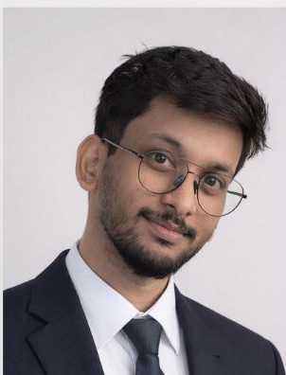
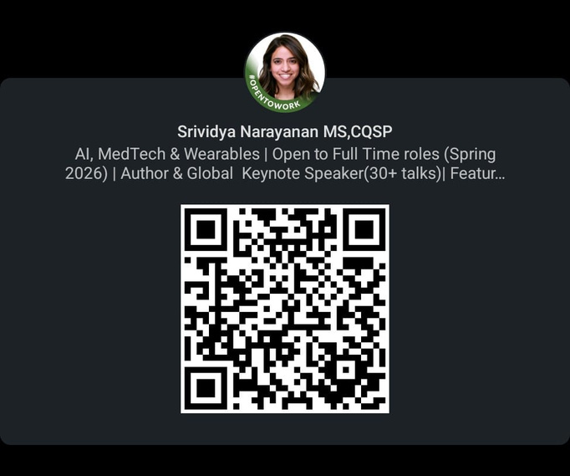
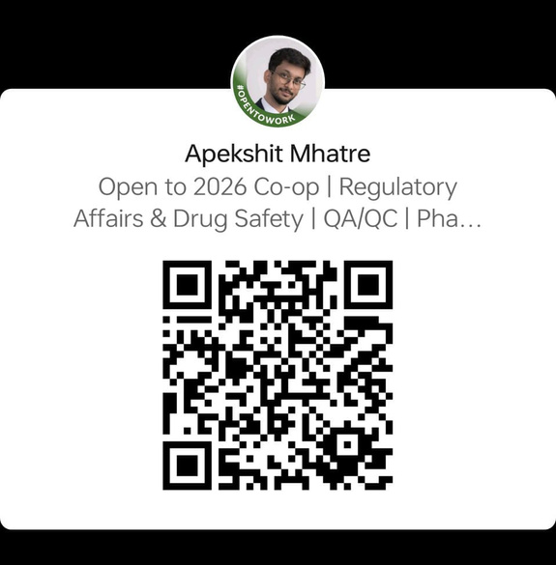
READY TO TRANSFORM YOUR CLINIC?
What we're asking for:
✓ Your vote on CardiQ
✓ Share with colleagues & other clinics
✓ Get the toolkit (slides + SOP + tools)
✓ Join early adopter pilot
Your support = clinical innovation wins
Dr Srividya
Narayanan
Apekshit
Mhatre
narayanan.sri@northeastern.edu
mhatre.ap@northeastern.edu
Thank you for caring about alert triage.

