Slide 1
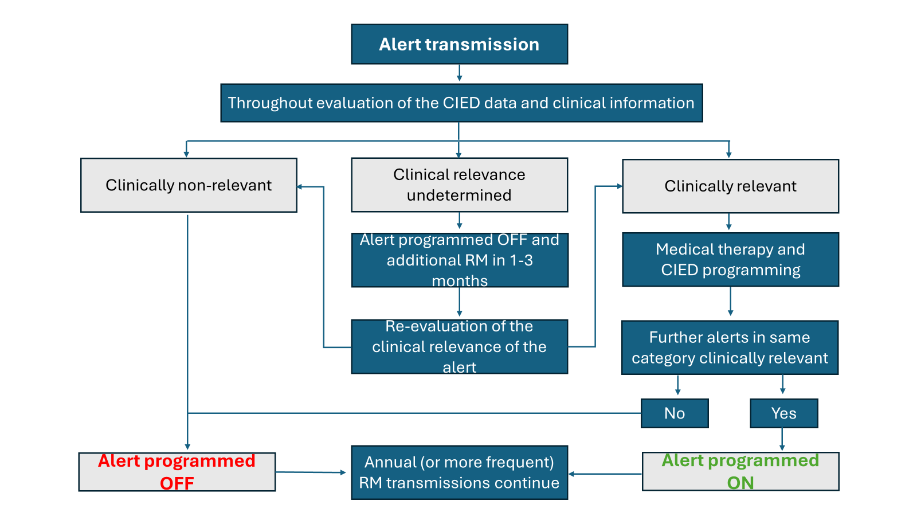

Solution for alert transmissions in Remote monitoring

