Slide 1
ADC Heart Failure Program
review of aDC hf Data, process, and outcomes

Slide 2
AGENDA
Overview of ADC HF Program
Vendor algorithm data review/risk factors
The year of 2024- Building the platform, what worked, what didn't work and what we learned
Financials
Data collected from 6/1/24-1/31/25

Slide 3
Overview of ADC HF Program
Current Heart Failure monitoring program established February 2024 with the updated Medtronic Triage HF algorithm.
HF monitoring extended to Boston Scientific Heart Logic HF monitoring in May 2024.
HF reports are scheduled monthly.
Alerts will trigger for new high-risk status.
HF reports and alerts are reviewed by dedicated HF Device team during dedicated time on Tuesday and Thursday.
Data for volume and type of HF reports started being tracked July 2024.
Patient specific outcome data reviewed and recorded for timeframe 6/1/24-1/31/25.

Slide 4
Medtronic Triage HF Risk Assessment
Risk Factors:
Optivol: Change of Intrathoracic Impedance
Patient activity: < 60 min per day
AT/AF: > 1 hour per day
Ventricular Rate during AT/AF: > 90 bpm during AF >6 hours a day
% Ventricular Pacing: <90% (CRT device only)
Shocks: Delivered
Treated VT/VF: >5
Night Ventricular Rate: >85 bpm or <55 bpm
Heart Rate Variability: <60 ms
The risk status reported for the patient is based on the maximum daily risk status for the previous 30 days​

Slide 5


Medtronic Triage HF Risk Assessment
"Low", "Medium", or "High" Risk
When does the Triage HF Algorithm Run:
The algorithm is run when a report is received in Carelink
Routine scheduled remote transmission
Either for routine quarterly Pacer/ICD reports or for the monthly scheduled HF report
Manual transmission sent by patient
Care Alert triggered transmission
For any alert type that triggers a transmission
Optivol is a programmable alert that triggers a transmission
Triage HF data collection cannot be disabled
Triage HF Risk Status is not available on in person device interrogations
Triage HF data is available beginning 60 days after implant

Slide 6
Boston Scientific Heart Logic Diagnostic
 | Heart Logic Heart Failure Diagnostic Sensors
Heart Sounds (S1 &S3) | Measured from the accelerometer and reveals signs of elevated filling pressure and weakened ventricular contraction via S3 and S1 heart sounds. Heart sounds are measured every 20 minutes at rest and aggregated throughout the day.
Thoracic Impedance | Measures impedance between electrodes on the RV lead and the pulse generator, which is indicative of fluid accumulation and pulmonary edema. Thoracic impedance is measured every 2 minutes and aggregated throughout the day.
Respiration | Monitors respiratory patterns associated with shortness of breath including respiratory rate (RR) and rapid shallow breathing (using a ratio of RR to tidal volume). Worsening HF may be associated with an elevated RR, worsening rapid shallow breathing pattern, or an increase in day-to-day RR variability.
Night Heart Rate | Night HR is measured beat by beat then aggregated between midnight and 6 AM, which for most patients is indicative of the Resting HR.
Activity | Monitors a patient's activity in hours per day reflecting overall global patient status and fatigue. Low level of activity or declining activity level may be associated with worsening heart failure.
Available on Resonate CRT-D and ICD devices
The Heart Logic Index is a single indicator derived from a series of heart failure sensors.
Index is available beginning 30 days after implant

Slide 7
Boston Scientific Heart Logic Diagnostic
Heart Logic Index is computed daily as a number
An alert transmission is sent when the Heart Logic Index crosses the alert threshold
Current Alert threshold is set nominally to an Index of 16
Index must decrease below recovery threshold of 6 before patient is considered out of High-risk status
Recovery threshold and Alert thresholds are programmable.
If Index remains above recovery threshold, Device will re-alert every 7 days.
This is not programmable.
ADC does not process these 7-day re-alerts.

Slide 8
WHAT THE PROCESS LOOKED LIKE PRIOR TO 11/15/24
Prior to 11/15:
Created a monthly billable docket only for patients with a “high” HF reading.
All patients with devices capable of HF monitoring enrolled for a total of 394 pts.
7/23-11/14
1728 total reports (17% “high”)
avg 105 weekly (Median 108)
avg 6.7 hours dedicated to HF by ADC HF nurses per week (Median 6)
Estimated revenue: $4117.36 (billed for 188 HF reports)
Murj cost of platform $23, 640.00 billed in October for 2025

Slide 9
WHAT WE LEARNED DURING 2024
Not financially sustainable with all patients enrolled, only managing "HIGH" alerts
Patients needed to "earn" the requirement for HF monitoring
After 11/15:
Patients left enrolled in HF monitoring if a “high” reading alerted within the previous 12 months. All other patients unenrolled from HF monitoring.
If a routine Pacer/ICD report showed “high” HF risk, patient referred to the ADC HF Device team for routine HF monitoring.
Current # of patients followed for HF: 236 (as of 3/14/25)
Boston Scientific Heart Logic: 101
Medtronic Triage HF: 135
All patients billed for monthly HF monitoring.

Slide 10
FINANCIALS
•$60/ANNUAL PT COST FOR MURJ
•$22.22/PER BILLING INTERVAL MEDICARE REIMBURSMENT
•CURRENT TOTAL PT ON HF PLATFORM- 236
•Q 31 DAY INTERVALS= 11 BILLING NTERVALS IN 12 MONTH CYCLE
•236 PTS X11 INTERVALS = 2596 BILLING OPPORTUNITIES= $ 57,683.12 (+REVENUE)
$57,683.12-$23,640 2025 MURJ COST= $34,043.12 - NURSING COST ?
2026 FINANCIAL PROJECTION
•236 PTS X$60= $14,160 (ANNUAL MURJ PLATFORM COST)
• 236 PTS X11 INTERVALS = 2596 BILLING OPPORTUNITIES= $ 57,683.12
• $57,683.12- $14,160= $43,523.12 = + REVENUE- NURSING COST?
SELF SUPPORTING

Slide 11
CURRENT WORKFLOW FOLLOWED FOR INITIATION AND MANAGMENT
HEART FAILURE MANAGEMENT
INITIATING AND MANAGING HF INTERVAL

Slide 12
EPIC SUPPORTING DOCUMENTATION HF SMARTPHRASE
Have you experienced any new or worsening shortness of breath? If yes, over what period of time?
Have you experienced any new or worsening leg swelling or belly distention? If yes, over what period of time?
Have you noticed a sudden increase in weight (in the past 1 -2 weeks)?
Have you experienced any new or worsening fatigue? If yes, over what period of time?
Have you been experiencing any recent ill health or recent hospitalization?
Are you taking your medications as per your physician order?
Patient instructed to please call 911 or go to the nearest emergency room if at any time they require urgent medical attention.

Slide 13
HF DATA OBTAINED AFTER WORKFLOW MODIFICATIONS
11/16-1/31
1214 total reports (17% “high”)
avg 80 weekly (Median 64)
avg 6.5 hours dedicated to HF by nurses per week (Median 6)
Estimated revenue: $17,598.24 (billed for 792 HF reports)
Avg 5.7 call per week for symptom check

Slide 14
Patient data with “High” HF risk status 6/1/24-1/31/25:
Data collected for each patient's monthly HF interval reading “high risk"
Total continuous “high risk" monthly intervals tracked: 240
Total number of patients followed for “high risk” HF reports: 164
If a patient HF status goes below the alert indicator, the period ends.
If a patient goes above the high-risk alert indicator again, a new tracked interval is started.

Slide 15
Data tracked per continuous "High HF risk" interval:
Patient age (avg age 70.7 years)
Device Company
# of consecutive high-risk months
Hypervolemia symptoms reported,
Response from MD/NP
Changes made to orders
Followed by Heart Failure Clinic at time of alert
Any hospitalizations during high-risk status
CHF hospitalizations during ADC HF monitoring period (6/1/24-1/31/25) or prior to ADC HF monitoring (2023-5/2024)

Slide 16
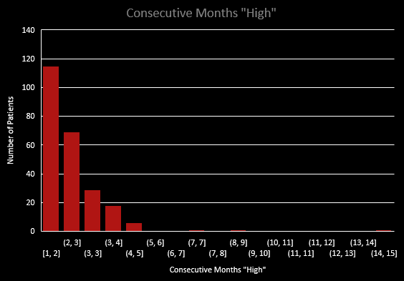
Consecutive "High" Monthly Intervals
The range for continuously “high” monthly reports in the data set is 1-14 months with a median of 2

Slide 17
Total High-Risk Periods
Boston Scientific Heart Logic:
Medtronic Triage HF:
Total high intervals tracked=121
Patient reported “yes” to symptoms at any point during the “high-risk” interval=26
21.4% of patients above the alert trigger reported symptoms of hypervolemia
Total high intervals tracked=119
Patient report “yes” to symptoms=40
33.6% of patients in the "high" range reported symptoms of hypervolemia
Patients followed by Heart Failure Clinic at time of high-risk alert=58 out of 240 (24% of total high-risk intervals)

Slide 18
MD/NP response (80 total sent for review)

Slide 19
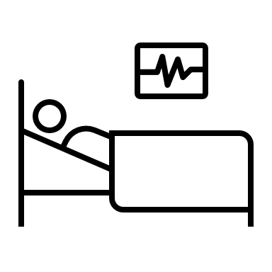
Outcomes
Out of 9 total patients where a decision was made to not change medication orders or order lab work after the patient alerted "High-risk" for HF on their device AND the patient reported symptoms of hypervolemia:
3 (33%) were admitted for CHF within 3-6 days.

Slide 20
Hospitalizations
164 total patients alerted for "High HF risk" and tracked
85 total hospitalizations during/near “high-risk” alert across all patients tracked (including any diagnosis type)
Hospitalizations for CHF
* 16 total patients out of the group were admitted for CHF
* 26 total CHF hospitalizations (Range of 1 to 5 across those 16 patients)
* 9.7% of all “high HF risk” patients were subsequently admitted for CHF
Total hospitalizations
Total Patients
6/1/24-1/31/25

Slide 21
Outcomes
Out of 55 patients who reported symptoms of hypervolemia, 9 (16.4%) were admitted for CHF during/near “high HF risk” time frame regardless if orders were changed or not
Of the 9 patients:
3 did not have med changes or labs ordered prior to hospitalization
2 patients were admitted after med changes were ordered
At 4- and 7-days post changes
Both patients were followed by the Heart Failure Clinic
3 patients were already hospitalized when reviewed for HF status and had meds changed while hospitalized.
2 patients were excluded from above categories:
1 patient was admitted to hospice during the "high status"
1 Patient had ortho surgery one day prior to CHF admit.

Slide 22
Limitations:
21% of calls made for symptom check were not returned by patients.
392 total calls made. 84 calls not returned by the patient.
If call is not returned, ADC HF nurse documents “no return call, will continue to monitor HF status via device.”
Lack of understanding and mistrust of data from providers
Leads to miscommunication to patients
Pt's statement "my dr says it's not accurate so I don't have to worry about it"

Slide 23
Reference Data for ADC Heart Failure Tracking:
HF Tracking.xlsx

